Slide 1
FIN 7830 GROUP 2 PROJECT PRESENTATION
HSBC ALGORITHMIC TRADING STRATEGY DEVELOPMENT

Slide 2
GROUP MEMBERS
Prasadi Samaranayake (19456719)
Shi Yongfen (19457138)
Muhammad Nabeel Abbasi (19451792)
Nursaiyn Bakyt (19453647)
Nnamdi Olisaeloka (19449534)
George Li (19453949)
Zheng Zhongyi (19449739)
Ubeydullah Sark (19456662)

Slide 3
TABLE OF CONTENT
DATA COLLECTION
STOCK ANALYSIS
STRATEGY DERIVATION
OUT OF SAMPLE TEST
DEFINITION OF TERMS

Slide 4
DATA COLLECTION

Slide 5
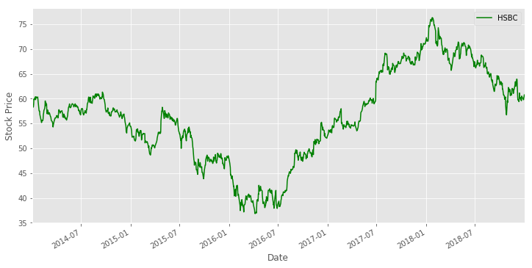
HSBC STOCK PRICE DATA (2014 – 2018)
Python Code
Import pandas_datareader.data as dr
from datetime import date
ticker = '0005.HK'
start = date(2014,1,1)
end = date(2018,12,31)
HSBC = dr.DataReader(ticker,'yahoo', start, end)
HSBC['Adj Close'].plot(label='HSBC', figsize=(12,6), c='g' )
We collected the five year historical HSBC stock price data (2014-2018) from the Yahoo Finance website with the help of the pandas data reader.
The graph above shows the HSBC Adjusted Close data using the pandas line plot function.

Slide 6
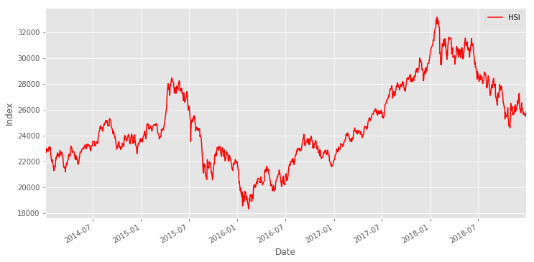
HANG SENG INDEX DATA (2014 – 2018)
Python Code
ticker = '^HSI'
start = date(2014,1,1)
end = date(2018,12,31)
HSI = dr.DataReader(ticker,'yahoo', start, end)
HSI['Adj Close'].plot(label='HSI', figsize=(12,6), c='r')
We collected the five year historical Hang Seng Index (HSI) data (2014-2018) from the Yahoo Finance website with the help of the pandas data reader.
Shown above is the HSI Adjusted Close data using the pandas line plot function.

Slide 7
STOCK ANALYSIS

Slide 8
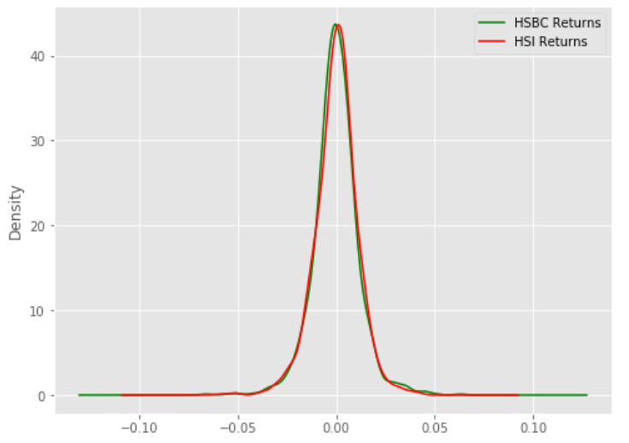
DAILY RETURNS DISTRIBUTION
Python Code
HSBC_return = pd.DataFrame(HSBC['Adj Close'].pct_change())
HSI_return = pd.DataFrame(HSI['Adj Close'].pct_change())
plt.figure(figsize=(8,6))
plt.style.use('ggplot')
HSBC_return['HSBC Returns'].plot.kde(c='g')
HSI_return['HSI Returns'].plot.kde(c=‘r')
We visualised the HSBC and HSI daily returns distribution using the pandas kernel density estimate plot function.
As shown above, they have very similar distributions and they both seem to follow a normal distribution.

Slide 9
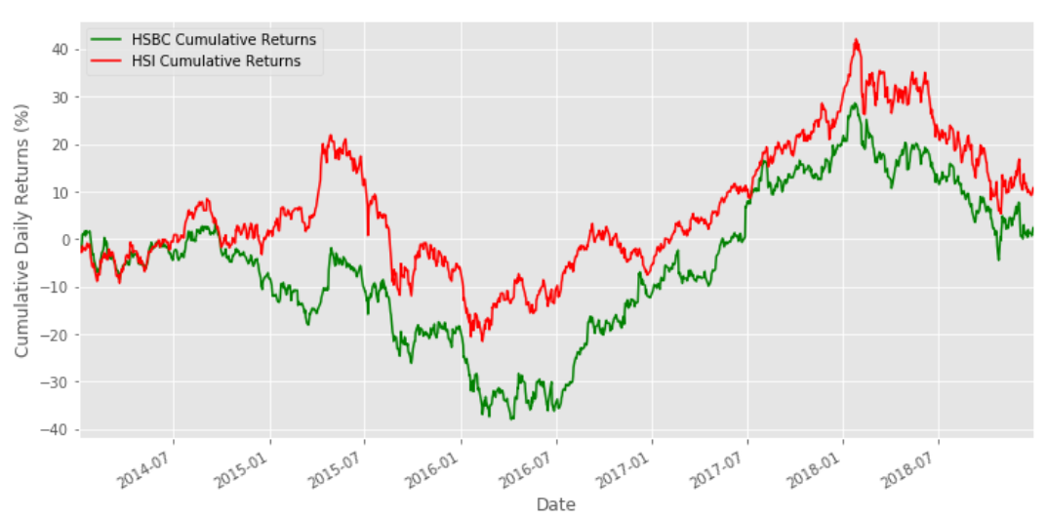
CUMULATIVE RETURNS
Python Code
plt.figure(figsize=(12,6))
plt.style.use('ggplot')
HSBC_cum_return['HSBC Cumulative Returns'].plot(c='g')
HSI_cum_return['HSI Cumulative Returns'].plot(c=‘r')
We visualised the HSBC and HSI cumulative returns distribution using the pandas line plot function.
In general, the HSBC and HSI seem to follow similar upward and downward trends, with the HSI having higher cumulative returns.

Slide 10
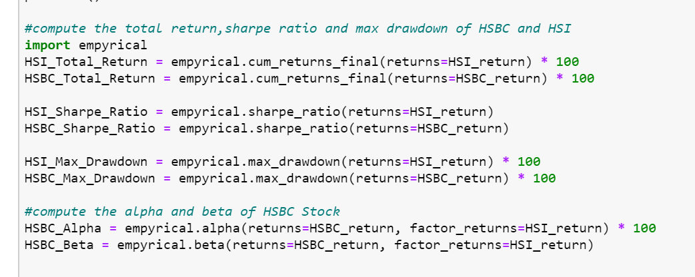
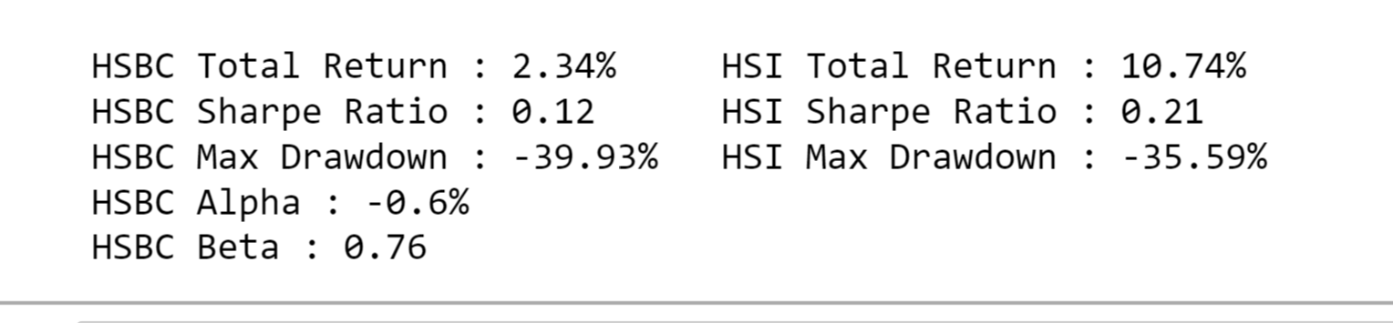
PERFORMANCE STATISTICS
Shown below are HSBC stock performance statistics that were computed using functions from the empyrical package.

Slide 11
STRATEGY DERIVATION

Slide 12
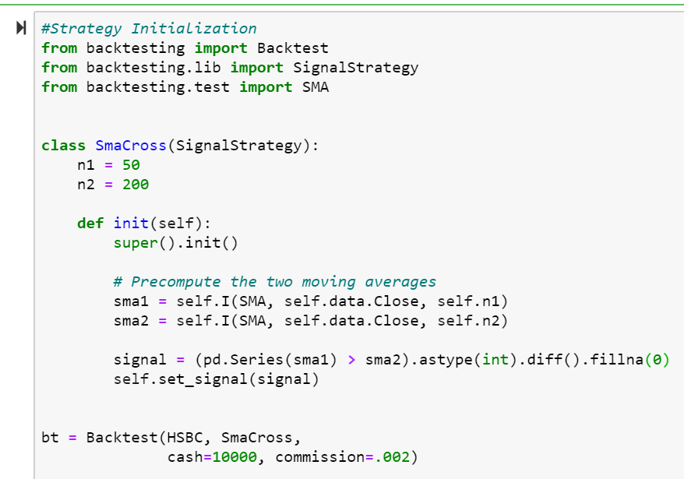
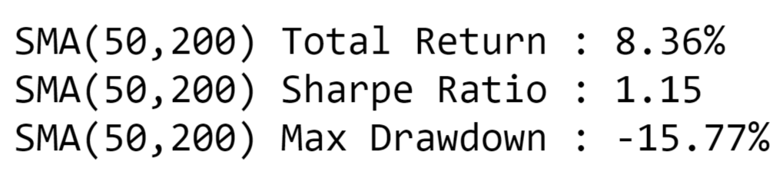
INITIALIZATION
We back tested the performance of our experimental moving average crossover strategy using functions and modules from the backtesting package.

Slide 13
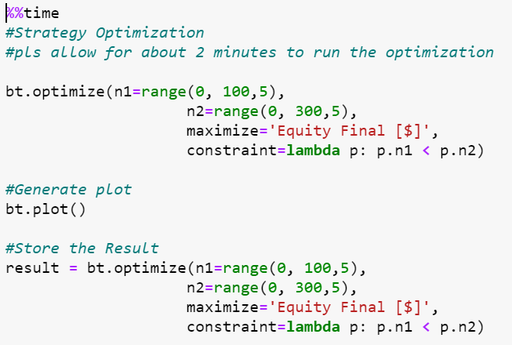
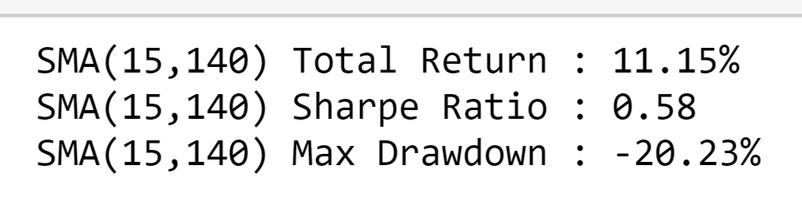
OPTIMIZATION
We optimized the performance of our experimental strategy using the optimize function from the backtesting package.

Slide 14


COMPARISON
Benchmark
Initial Strategy
Optimized Strategy
With our experimental simple moving average crossover strategy, we are able to obtain better performance results compared to the benchmark return, sharpe ratio and max drawdown on the HSBC stock.

Slide 15
OUT OF SAMPLE TEST

Slide 16
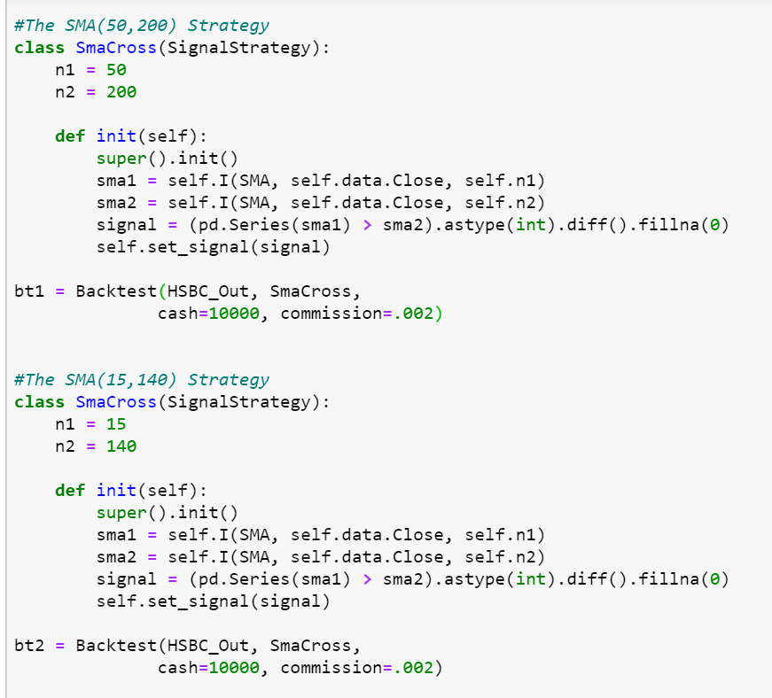
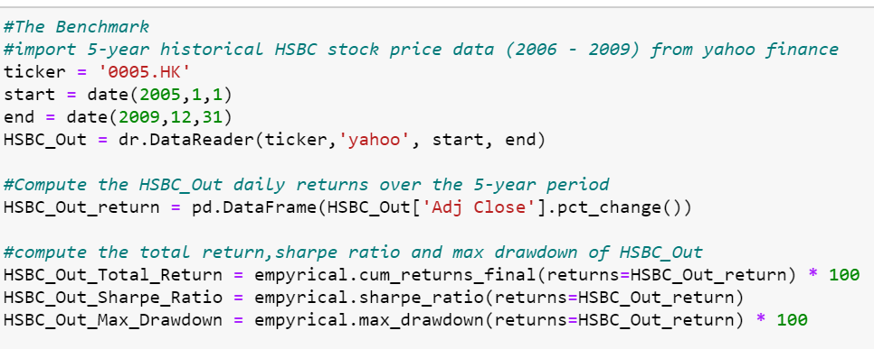
OUT-OF-SAMPLE TEST (2005 – 2009)
We tested the performance of our experimental strategies on an out-of-sample data set collected from 2005 -2009.

Slide 17
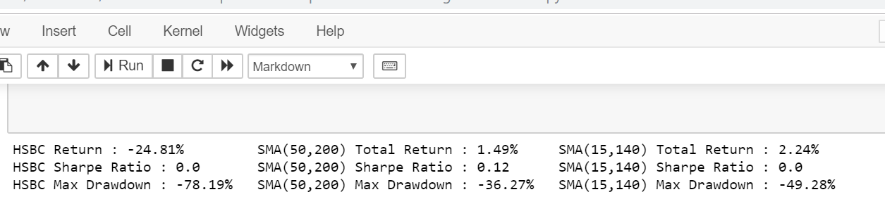
TEST RESULT
Benchmark
Initial Strategy
Optimized Strategy
Our out-of-sample test result confirms the validity and consistency of our experimental simple moving average crossover strategy.

Slide 18
DEFINITION OF TERMS

Slide 19


PERFORMANCE TERMS
Alpha: The excess return of an investment relative to the return of a benchmark index.
Beta: A measure of the volatility of an individual stock in comparison to the entire market.
Sharpe Ratio: The average return earned in excess of the risk-free rate per unit of volatility or total risk.
Total Return: The actual rate of return of an investment over a given evaluation period.
Maximum Draw-Down: An indicator of downside risk over a specified time period.
$$α$$
$$β$$

Slide 20
THANK YOU

